Slide 1
Building Math Talk for Sense Making in the Classroom
Karen C. Fuson
Northwestern University
Professor Emerita
My website is karenfusonmath.com
Author of Math Expressions
a PK to Grade 6 math program
Notes:
.

Slide 2
A nurturing meaning-making visual Math Talk Community
is an inquiry-based teaching/learning environment, and
has a continual focus on sense-making by all participants.
Students are expected:
to understand what they are doing,
come to be able to explain their thinking,
understand the thinking of other students,
learn to seek help when they need it, and
help others who need it.
Notes:
.

Slide 3
Create a Nurturing Sense-Making Math Talk Community
The teacher orchestrates collaborative instructional conversations focused on the mathematical thinking of students, using these responsive means of assistance that facilitate learning and teaching by all:
Engaging and involving
Managing
Coaching which is modeling, clarifying, instructing/explaining, questioning, feedback
Notes:
.

Slide 4
Support Sense-Making in the Math Talk Community
The teacher supports the sense-making of all classroom members by using and assisting students to use and relate:
Mathematical situations
Pedagogical supports especially drawings
Cultural mathematical symbols and words
Student’s own explanations of their thinking
Notes:
.

Slide 5
Solve and Discuss Classroom Structure
Solve All students solve. Some solve at the board, and the rest at their seats. | Explain One student at the board explains and then asks, “Are there any questions?” | Question Other students ask questions to clarify or extend. | Justify The original explainer responds to the questions by explaining more (justifying the original explanation).
Any student at any time can ask for help from anyone.
For more practice, Solve and Discuss can take place in pairs or small groups.
Notes:
Do not take class time for you or a student to write out a method while nothing else is happening. That is a major advantage of the Solve and Discuss structure: the methods to be discussed are visible.

Slide 6
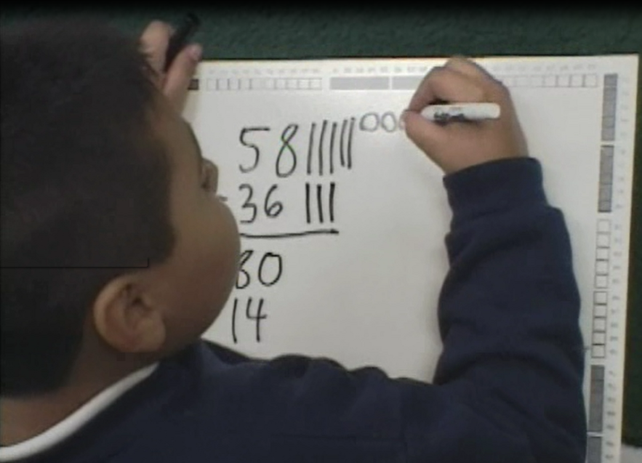
Make the math thinking visible
Students must make some kind of math drawing related to the math symbols to show their thinking.
This supports understanding by the listeners and promotes meaning.
Notes:
.

Slide 7
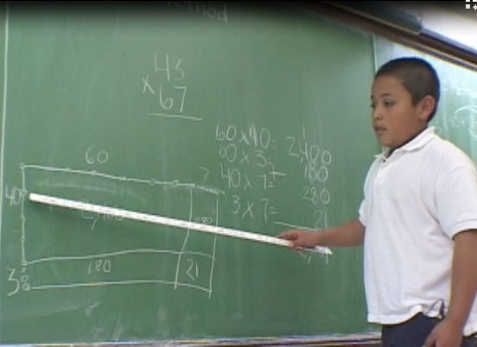
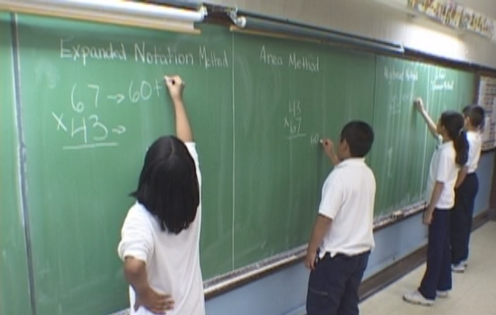
Make the math thinking visible
This is important for equity: less advanced students and English Learners are helped by the math drawing linked to the explanation by pointing.
Be sure that important methods remain on the board or can be made visible again (e.g., on a Math Board) so they can be compared with other methods.
Notes:
Do not take class time for you or a student to write out a method while nothing else is happening. That is a major advantage of the Solve and Discuss structure: the methods to be discussed are there.

Slide 8
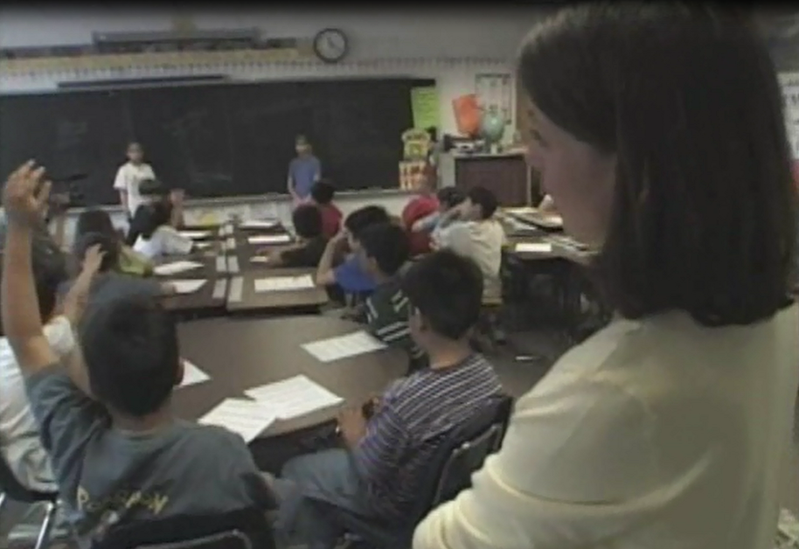
Students must speak and not just listen
1. Structure opportunities to explain to a partner and repeat what the partner says, if needed. Students eventually find their own words, but may need the security of saying an explanation they know is correct.
2. “Bite your tongue” to provide wait time. Students will explain, ask questions, or add a comment if you wait.
3. Help students speak to classmates by moving to the side or back of the room. Later remind students with a silent gesture to address each other.
Notes:
.

Slide 9
A nurturing meaning-making visual Math Talk Community is what students and teachers need to recover from the deprivations of the covid years. It is therapy for the soul and the self. Everyone needs to belong to a community in which your thinking and your self is valued and in which you can help others.
Notes:
.

Slide 10
A nurturing meaning-making visual Math Talk Community allows you to individualize within whole-class discussions: . Several methods arise and are discussed, and you can introduce research-based methods that are accessible and mathematically desirable. With the classroom math talk support, all students move to a strong method.
Notes:
.

Slide 11
Students develop math drawings to show their thinking.
Notes:
Each new math topic goes through the 3 levels. The levels may occur in 1 class period or over as much as 2 or 3 weeks.

Slide 12
Teachers continually assist students to do math sense-making about math structure using math drawings to support math explaining.
Notes:
.

Slide 13
Balanced Inquiry Learning Path teaching requires
situational diagrams, drawings of numbers, and
mathematically-desirable and accessible computational methods.
My many years of classroom research focused on finding, developing, and testing these in varied classrooms of students.
These all involve learning paths to bring students from where they start to fluency with advanced enough methods.
You can find details of all of these on my website in the Teaching Progressions and in the Classroom Videos.
karenfusonmath.com
Notes:
.

Slide 14
Teaching Progressions on karenfusonmath.com
Notes:
.

Slide 15
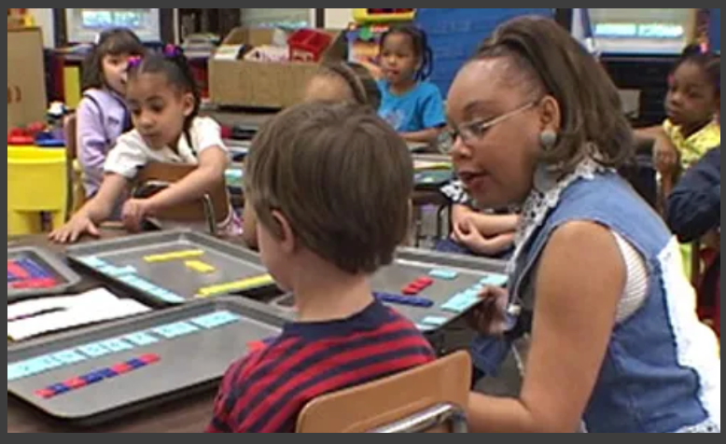
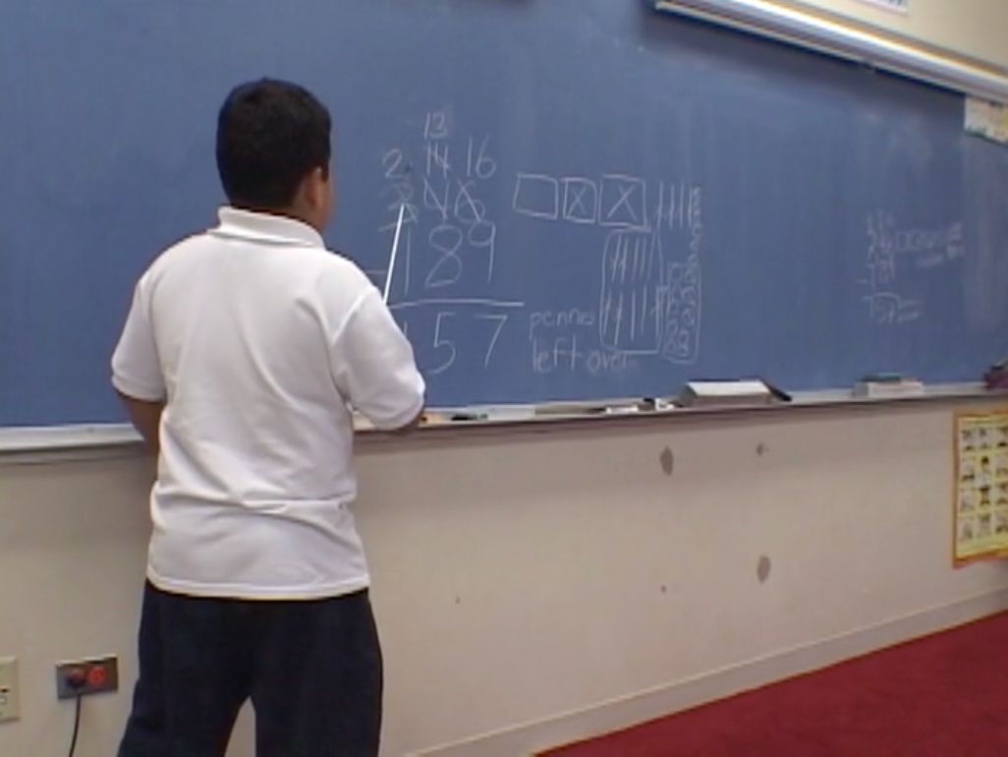
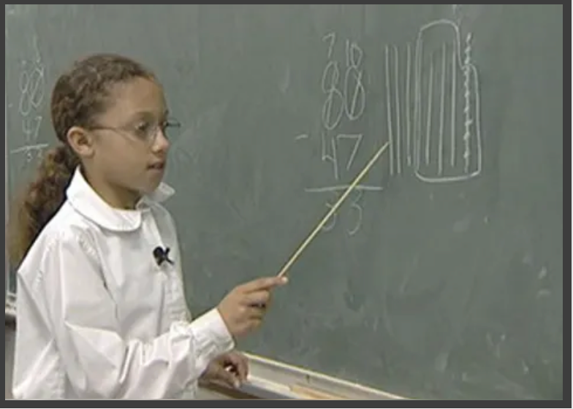
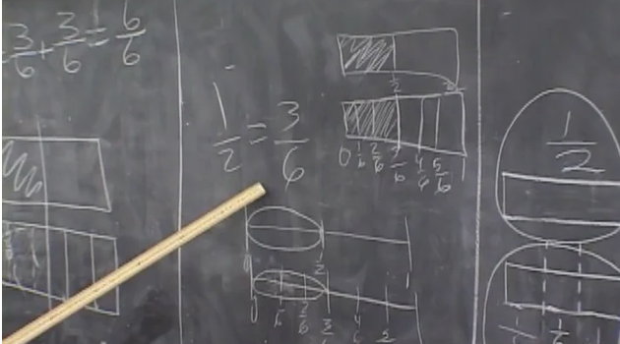
Classroom Videos on karenfusonmath.com
Notes:
.

Slide 16
The About menu on karenfusonmath.com
gives my background and describes each of the menu choices.
These include my publications and
visual presentations about my research.
The Teaching Progressions and Classroom Videos show the visual representations that help students show their thinking. They have been used in my math program Math Expressions to show that they work, but they can be used by anyone.
My email is karenfuson@mac.com
Notes:
.

Slide 17
Expanding Number Talks
to Build Equitable Math Talk Classrooms
by Karen Fuson and Steve Leinwand
The paper above appeared in the March NCTM journal Mathematics Teacher: Learning and Teaching PK to G12.
It describes how limiting Number Talks are and how they can be extended to Math Talk in all lessons by having students use and discuss drawings and written methods.
It discusses some kinds of drawings students can make for different math domains, so it is a good resource for you in starting your Math Talk Community.
Notes:
.

Slide 18
There is no one “standard algorithm.” There are variations in ways
to record efficient, accurate, and generalizable methods that
form the collection of standard algorithms.
There are better methods; my research is about these. These are in Classroom Videos, papers, and Teaching Progressions on my website.
These are the mathematically desirable and accessible methods
that are standard algorithms.
Most taken to be “standard algorithms” are difficult or misleading.
The CCSS say in the critical area for the first year of a given computation: “Students develop, discuss, and use efficient, accurate, and generalizable methods.”
They do not say to wait until Grade 4 to do “standard algorithms.”
More details are in the paper below (it is on my website under publications).
Fuson, K. C. & Beckmann, S. (Fall/Winter, 2012-2013). Standard algorithms in the Common Core State Standards. National Council of Supervisors of Mathematics Journal of Mathematics Education Leadership, 14 (2), 14-30.
Notes:
.

Slide 19
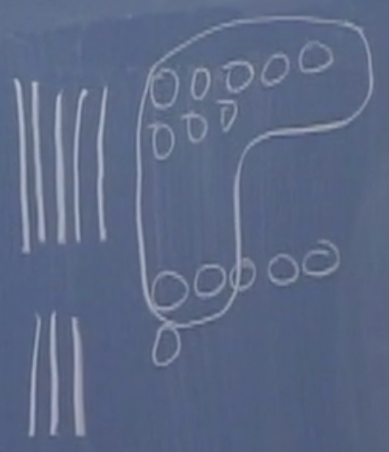
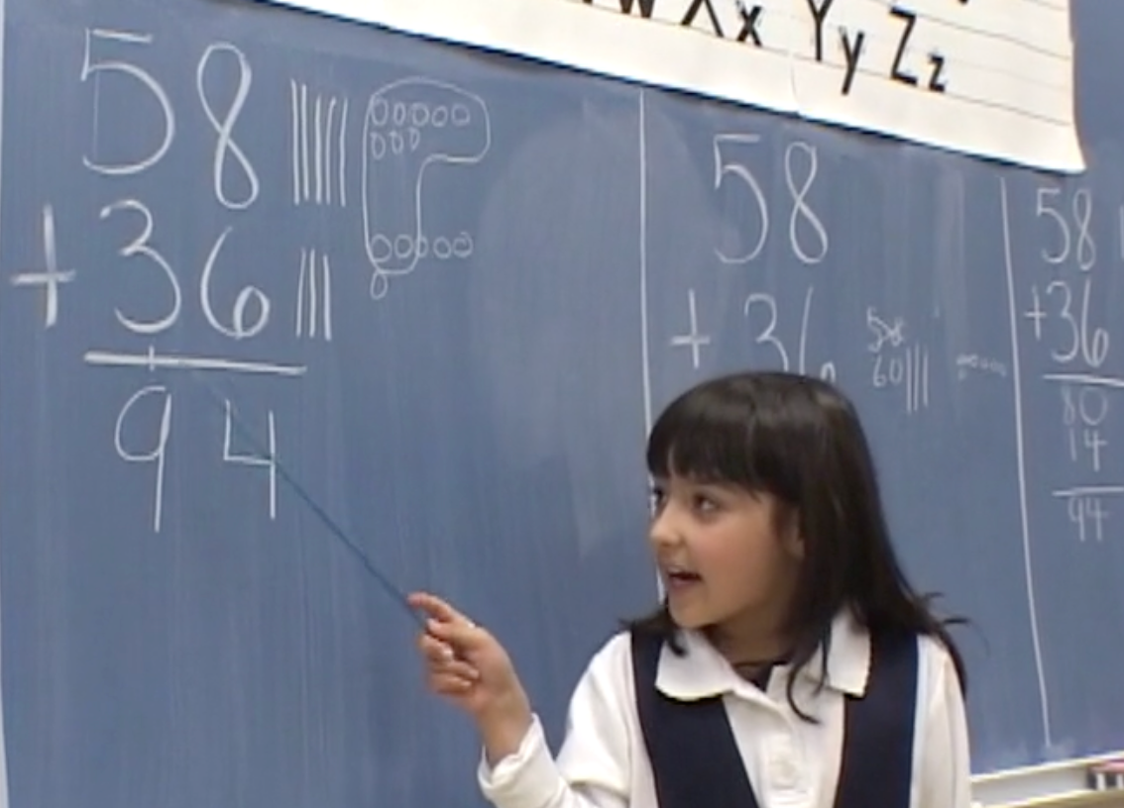
G1 New Groups Below 1.NBT.4
5 8
3 6
1
4
Notes:
New Groups Below involves a small change in the location where you write the new ten (or later hundred or thousand, etc.), but this method is easier and more comprehensible to students in several ways.
You see the 14 as one number.
You add the bigger numbers that are there and then add the 1. This is easier and you don’t forget the 1.
You don’t change the problem by writing some new number up in the problem space.
You write the 14 in the order you usually write it: the 1 ten then the 4 ones.

Slide 20
New Groups Below New Groups Above
Notes:
.

Slide 21
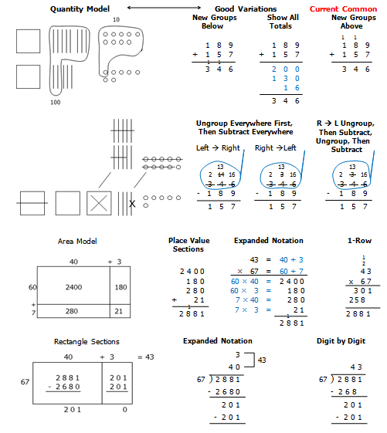
Drawings and Written Variations of Standard Algorithms
a
Notes:
.

Slide 22
Students develop math drawings to show their thinking.
Notes:
Each new math topic goes through the 3 levels. The levels may occur in 1 class period or over as much as 2 or 3 weeks.

